Slide 1



Learning Needs Matrix
(Identify Industrial Needs using LNM)
Centre for Industrial Design (OPEN DESIGN SCHOOL)
Gujarat Technological University, Ahmedabad

Slide 2
LN Matrix (Paper size A2 – 18” x 24”)
Learning Needs Matrix will help students to identify the learning requirements that are much needed in industry or in their career at an early stage along with prioritization of specific learning.
Identification will be focused with listing out Syllabus based and out of syllabus learning & skill development.
LNM is not necessarily related to their ongoing or future projects, but the learning needs may be generalized as per the industrial requirements of skillsets.
Students can maintain the same LNM sheet till final year (8th sem) and learn the specific skill sets that they want to pursue.

Slide 3
Learnings Need Matrix
Group ID: _____________
Date: _________
Theories/ Methods/ Application Process
Involved/ Mathematical Requirement
During BE IV / Stage III
Applicable standards and design specifications/ Principles & Experiments
During BE III / Stage II
During BE II / Stage I
Domain of skill-sets to be learned
Establish connections among skillsets – Create Groups
Component materials & strength criteria (exploration – varieties/ testing requirements)
Software/ Tools/ Simulation Methods/ Skill
With help from Bhasker V. Bhatt, SCET, Surat & GIC- Centre for Industrial Design Version: 03

Slide 4
LNM Guidelines
Every Student needs to identify requirements in each four dimensions/ quadrants in 4th semester and carry that LNM till 8th semester. You may refine your LNM and make versions as if your needs would change.
The semester wise allocation for each skill sets need to be done by student and guide. Priority learning shall be taken up as per the core subject of each semester.
Guide will track and evaluate the learnings of students through LNM. Students may co-learn the skill sets with other students.

Slide 5
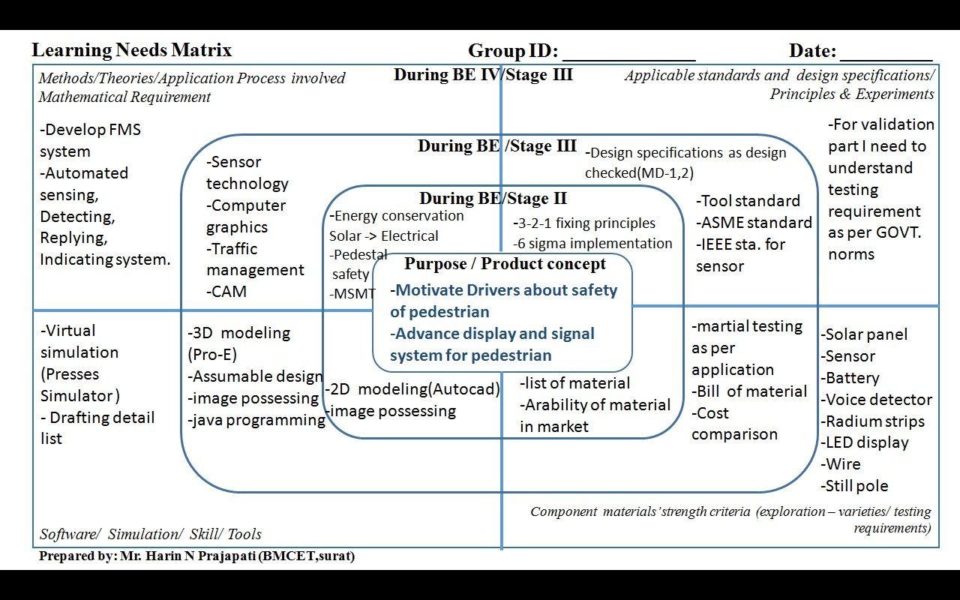

Slide 6
Thank you
Should you have any query, kindly write us at: design@gtu.edu.in
For more information, kindly visit us at: http://de.gtu.ac.in/

